Slide 1
POWER PLANTS
Module 3

Slide 2
POWER PLANTS
A power plant is an industrial facility used to generate electric power with the help of one or more generators which converts different energy sources into electric power.
Electricity is a secondary energy source - obtained from the conversion of other primary sources of energy :- coal, natural gas, nuclear, solar, hydraulic or wind energy.
Electricity itself is neither renewable nor non-renewable.
The power plant is the location in which the energy conversions take place.

Slide 3
Conventional Power Plants
Fossil fuel power plants: Generates electric power by burning fossil fuels like coal, natural gas or diesel.
Nuclear power plants: Controlled nuclear reaction is maintained to generate electricity.
Hydroelectric power plants: Electricity is produced by building dams on suitable rivers.

Slide 4
Non-Conventional Power Plants
Wind power plants: The kinetic energy of wind is used to create power.
Solar power plants: Generates power by collecting solar radiation.
Geothermal power plants: Uses the natural heat found in the deep levels of the earth to generate electricity.
Biomass power plants: Natural organic matter is burnt to produce electricity.

Slide 5
Power Plants
Hydro-electric power plants
Thermal power plants
Nuclear power plants
Diesel power plants
Wind power plants
Solar power plants

Slide 6
Hydro - electric Power Plants
Hydro energy:- Energy generated by the force of water.
Production of electricity depends upon:-
Water level from the ground
Flow rate of water
Efficiency of turbine

Slide 7
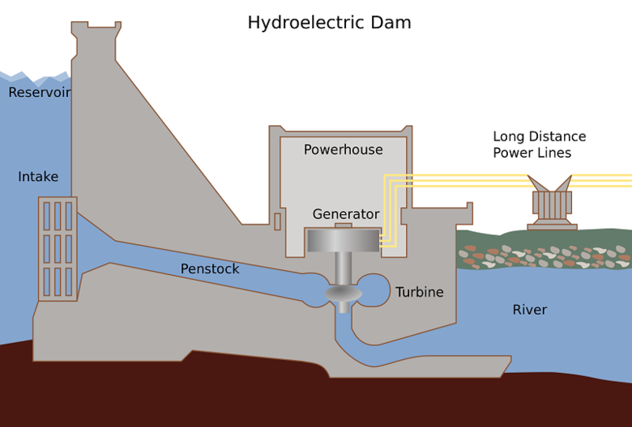
Hydro-electric Power Plants

Slide 8
Hydro-electric Power Plants
Advantages
The most important advantage is that it keeps the environment clean
Hydro energy can be stored in high level reservoirs and used whenever necessary.
Electricity is produced at a constant rate.
The life of dams and power plants last for many decades.
The water can be used for supplying
Drinking water
Irrigation
Water sports
Industries
Power plants

Slide 9
Hydro-electric Power Plants
Disadvantages
Constructing hydroelectric power plants and dams are very expensive.
Requires large area.
Planning a hydro electric power plant and reservoir may lead to the disruption of the lives of people as they have to relocate to another area.

Slide 10
Thermal Power Plants
A generating station which converts heat energy of coal combustion into electrical energy is known as a steam power station
The heat produced for burning of coal & with the help of water steam is produced. This produced steam flow towards turbine i.e. kinetic energy of the steam which converted into mechanical energy of the turbine. The input steam drives the prime mover or turbine, simultaneously the generator also start to rotate. At that time mechanical energy is converted into electrical energy.
Rankine cycle

Slide 11
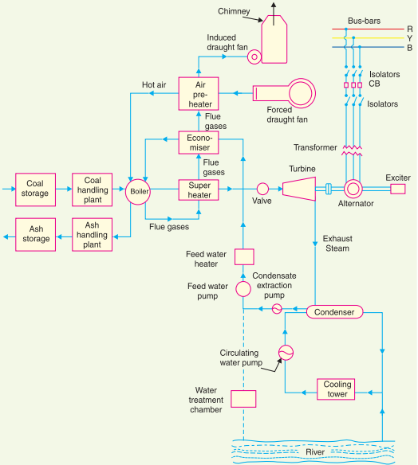
Thermal Power Plants

Slide 12
Thermal Power Plants
Advantages:
Less initial cost as compared to other generating stations.
It requires less land as compared to hydro power plant.
The fuel (i.e. coal) is cheaper.
The cost of generation is lesser than that of diesel power plants.

Slide 13
Thermal Power Plants
Disadvantages:
It pollutes the atmosphere due to the production of large amount of smoke. This is one of the causes of global warming.
The overall efficiency of a thermal power station is low (less than 30%).

Slide 14
Nuclear Power Plants
Nuclear power plants generate electricity in a very similar way to other traditional power plants, differing in the type of fuel used. All electricity generation plants produce heat that turns water into steam, which drives a turbine connected to a generator and subsequently produces electricity.
In a nuclear reactor, uranium atoms are split into smaller parts by changing their molecular structure using the fission process. The energy released during this split creates heat to produce steam, which is used by a turbine generator to generate electricity.

Slide 15
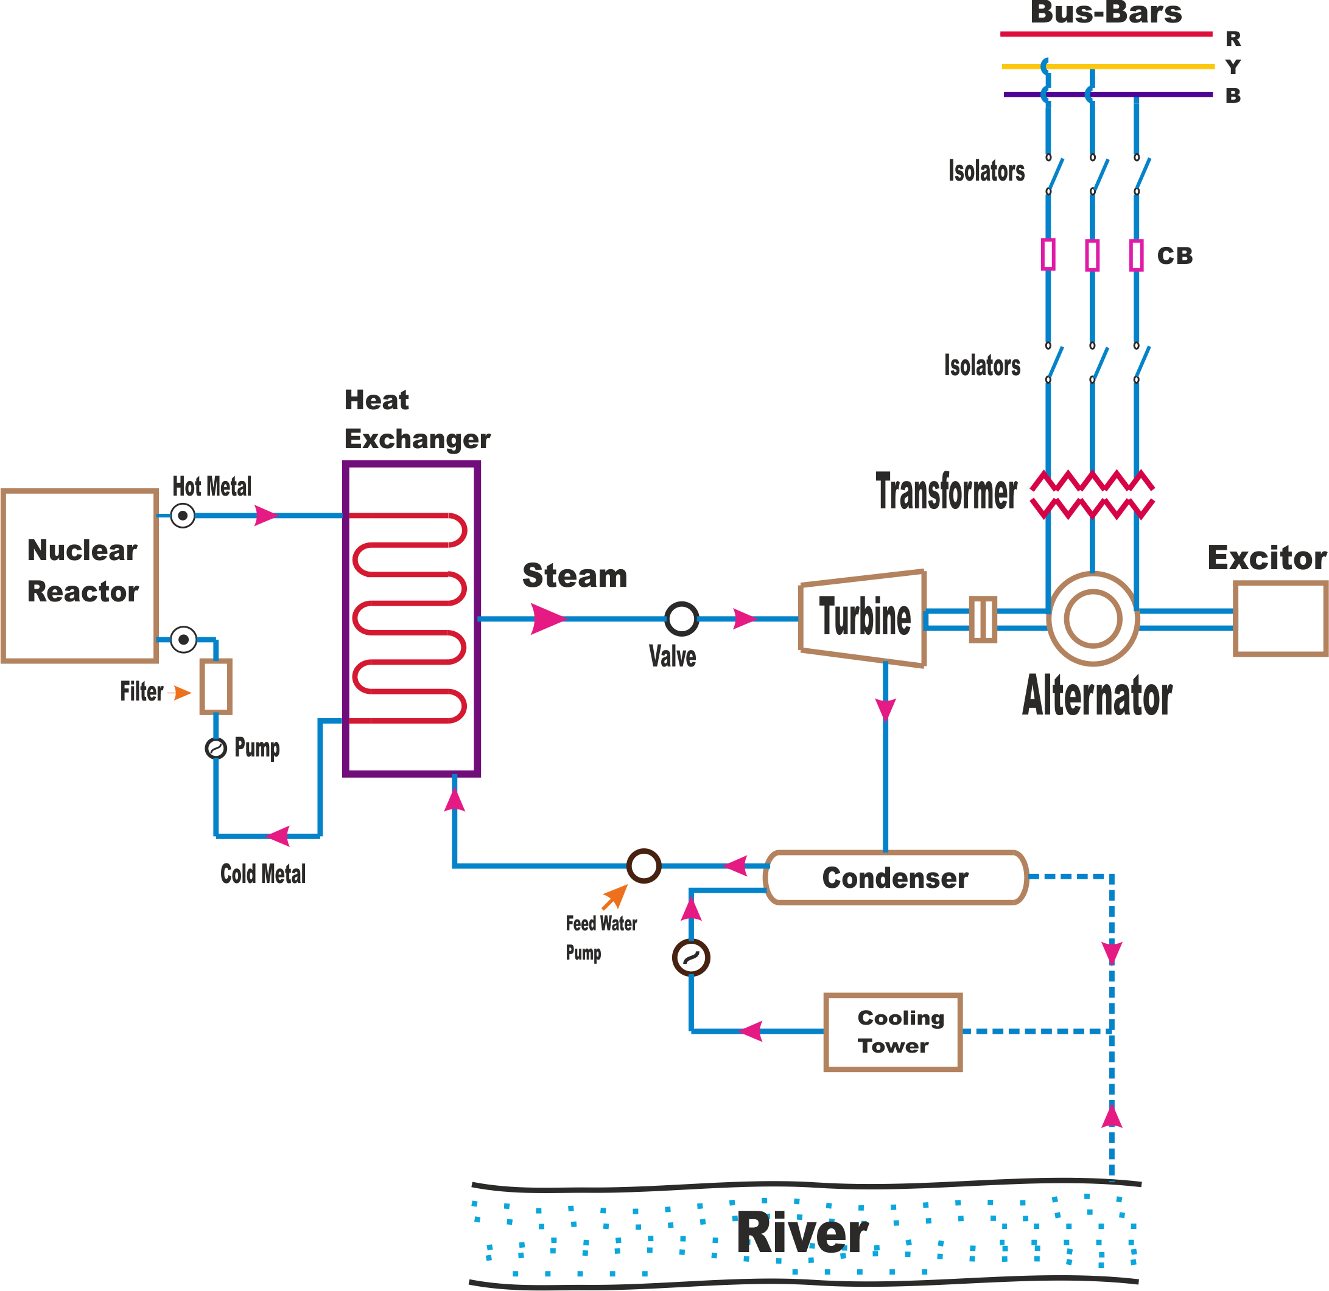
Nuclear Power Plants

Slide 16
Nuclear Power Plants
Advantages
Produces no polluting gases.
Does not contribute to global warming.
Low fuel quantity reduces mining and transportation effects on environment.
Power station has very long lifetime.

Slide 17
Nuclear Power Plants
Disadvantages
Waste is radioactive and safe disposal is very difficult and expensive.
Costs of building and safely decommissioning are very high.
Cannot react quickly to changes in electricity demand.
Local thermal pollution from wastewater affects marine life.

Slide 18
Diesel Power Plants
A Diesel power station (also known as Stand-by power station) uses a diesel engine as prime mover for the generation of electrical energy. This kind of power station can be used to produce limited amounts of electrical energy.
The diesel burns inside the engine and the products of this combustion act as the working fluid to produce mechanical energy. The diesel engine drives alternator which converts mechanical energy into electrical energy

Slide 19
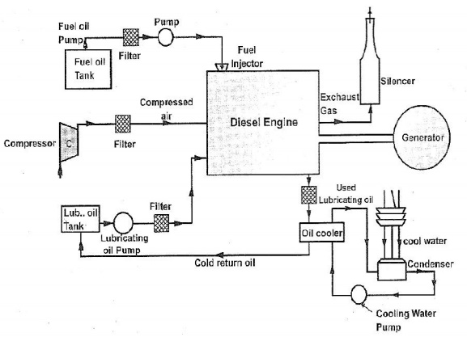
Diesel Power Plants

Slide 20
Diesel Power Plants
Advantages
Quick installation and commission
Quick starting and easy pick-up of loads
Easy operation
Required minimum labours
Simple fuel handling
Efficient ash disposal
High level of efficiency

Slide 21
Diesel Power Plants
Disadvantages
Limited power generation capacity.
Expensive due to the use of diesel.
High maintenance cost.
Relatively short life.

Slide 22
Wind Power Plants
Wind turbines operate on a simple principle. The energy in the wind turns two or three propeller-like blades around a rotor. The rotor is connected to the main shaft, which spins a generator to create electricity

Slide 23
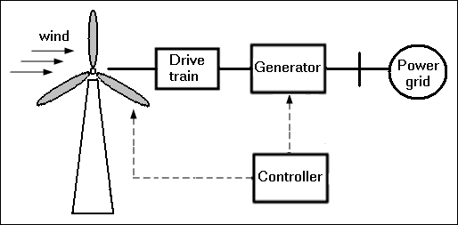
Wind Power Plants
Wind Power Plant.mp4

Slide 24
Wind Power Plants
Advantages
Clean & Environment friendly Fuel source
Renewable & Sustainable
Cost Effective
Industrial and Domestic Installation

Slide 25
Wind Power Plants
Disadvantages
Fluctuation of Wind and Good wind sites
Noise and aesthetic pollution
Not a profitable use of land

Slide 26
Solar Power Plants
A solar power plant is any type of facility that converts sunlight either directly, like Photovoltaics, or indirectly, like Solar Thermal plants, into electricity.
Photovoltaics
When photons from sunlight hit the semiconductor material free electrons are generated which can then flow through the material to produce a direct electrical current - known as the photo - effect in physics.
DC to AC - convertors
Can use the photo-effect directly without the need of other processes or devices.
Photovoltaic.mp4

Slide 27
Solar Power Plants
Solar Thermal Power Plants
These kinds of solar thermal power plant work by focusing sunlight from long parabolic mirrors onto receiver tubes that run the length of the mirror at their focal point. This concentrated solar energy heats up a fluid that continuously flows through the tubes.
This heated fluid is then sent to a heat exchanger to boil water in a conventional steam-turbine generator to generate electricity.
Solar Thermal Power plant.mp4

Slide 28
Solar Power Plants
Advantages
Renewable Energy Source
Reduces Electricity cost
Diverse Applications
Low Maintenance Costs
Technology Development

Slide 29
Solar Power Plants
Disadvantages
Weather Dependent
Solar Energy Storage is Expensive
Uses a Lot of Space
Associated with Pollution

